Slide 1


IE - 6318 - 001 Predicting molecular properties for Identification of new proteins
USING
DATAMINING TECHNIQUES
Guided by – Dr. Shouyi Wang
Presented by - Jayant Madan

Slide 2
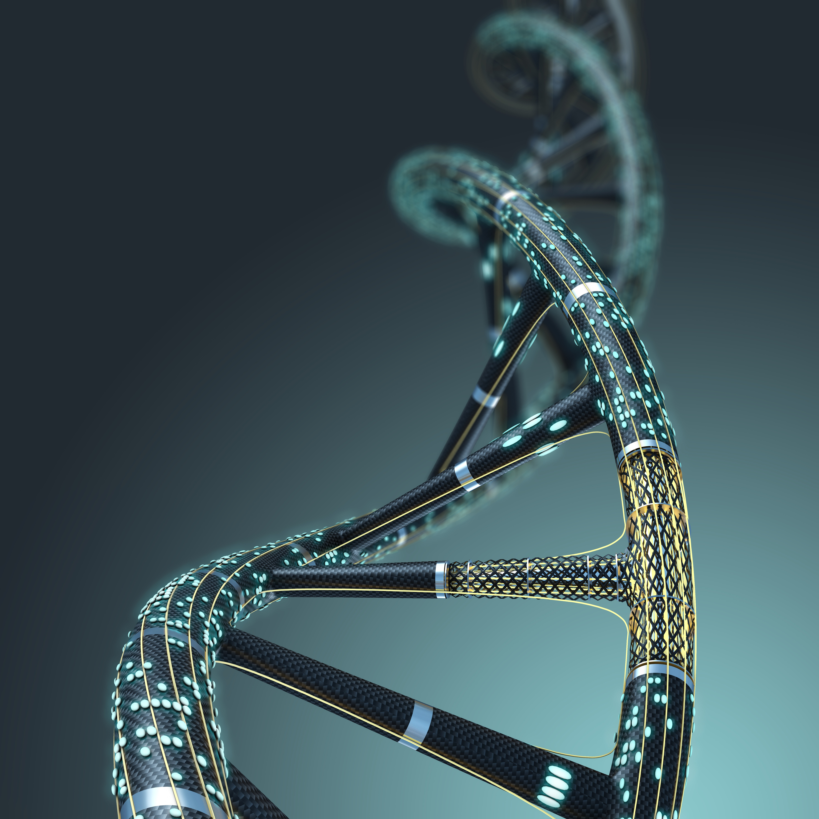
INTRODUCTION
PROTEIN ARE EXISTENT IN ALL LIVING BEING.
PROTEIN PLAY A VITAL CHEMICAL PROCESSES IN OUR DAILY LIVES.
PROTEIN CONSIST OF HUNDRED AND THOUSANDS OF AMINO ACIDS.
PROTEIN MAY FUNCTION IN MANY DIFFERENT WAYS AND HAVE MANY DIFFERENT FORMS

Slide 3
INTRODUCTION
PROTEIN ARE DECODED IN THE FORM OF CANONICAL SMILES.
MOST OF THE GENETIC DISEASE ARE A KIND OF GENETIC MUTATION.
THIS STUDY IS CONDUCTED TO ENCODE THE CANONICAL SMILES AND USE THEM TO PREDICT MOLECULAR PROPERTIES

Slide 4
INTRODUCTION
THE AMINO-ACID COMPOSITION AND PROPERTIES SUCH AS MOLECULAR WEIGHT PRODUCED BY A CERTAIN TYPE OF BACTERIA WHICH IS DIFFERENT FROM
THOSE OF PROTEIN FORMING COAT OF PARTICULAR VIRUS.
THE ABILITY TO IDENTIFY PROTEIN ALLOW RESEARCHERS TO DETERMINE WHETHER AN ORGANISM HAS A GENETIC DISEASE.

Slide 5
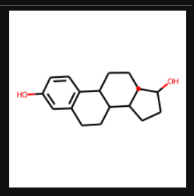
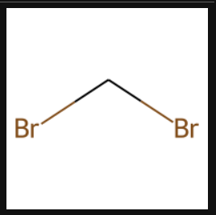
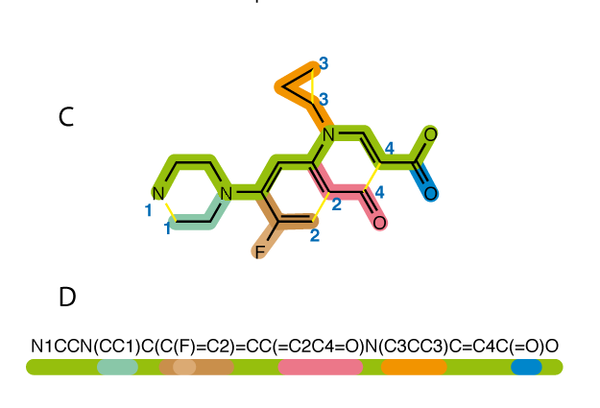
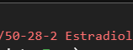
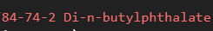
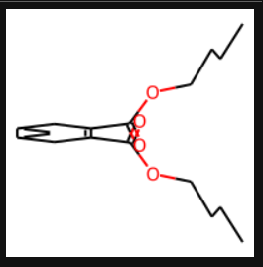
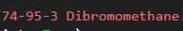
CAS NUMBER & CANONICAL SMILES
UNIQUE

Slide 6

DATA_MINING & MACHINE LEARNING
METHODOLOGY

Slide 7


DATA EXTRACTION

Slide 8



DATA EXTRACTION
56-23-5
CAS NUMBER
Carbon
Tetrachloride
(COMPOUND NAME)

Slide 9


DATA PREPROCESSING

Slide 10
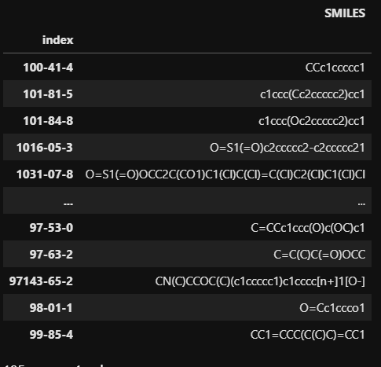
DATA PROCESSING
PROCESSING THE DATA IN TO MACHNE READABLE FORMAT
IN OUR CASE WE ARE CONVERTING CANONICAL SMILES IN TO
MACHINE REDABLE FORMAT

Slide 11
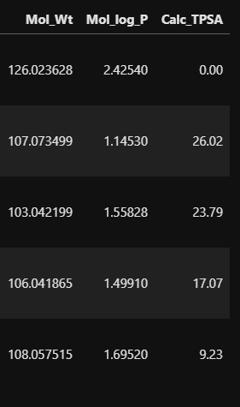
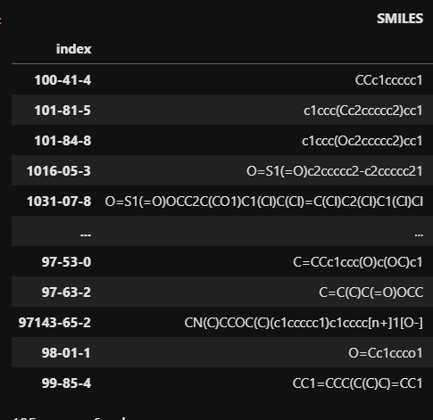
DATA PROCESSING
ExactMolWt
MolLogP
Calc TSPA
RDKIT

Slide 12


WHY
THESE THREE
PROPERTIES
BECAUSE MOLECULAR WEIGHT,
TOPOLOGICAL POLAR SURFACE AREA
AND LIPOPHILICITY
ARE
BEING WIDELY USED IN STUDYING
PROTEINS.

Slide 13
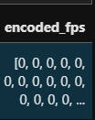
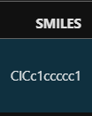
DATA PROCESSING
RDKIT
MolFromSmiles
GetAtomPairFingerprint
Fingerprints of chemical - A “fingerprint” is a vector that represents a
property of a chemical compound

Slide 14

MACHINE LEARNING MODEL SELECTION

Slide 15
REGRESSION IS A SUPERVISED
MACHINE LEARNING TECHNIQUE
WHICH IS USED TO PREDICT
CONTINUOUS VALUES.
AS IN OUR CASE WE ARE PREDICTING
MOLECULAR PROPERTIES
WHICH IS A CONTINUOUS VARIABLE.
THE GOAL IS TO PLOT THE BESTFIT
LINE BETWEEN THE DATA
IT HELP US TO PREDICT OUTPUT
VARIABLES USING DEPENDENT
INPUT VARIABLES
WHY
REGRESSION

Slide 16
K-Nearest Neighbour regression
Multioutput regression
Random forest regression
Gradient boosting

Slide 17

MOLECULAR PROPERTIES
Molecular weight
Lipophilicity
Topological polar surface area
FINGERPRINTS
DECODED
FROM
SMILES
MODEL INPUT
195 OBSERVATIONS
SPLIT AT 33%
130 TRAINING AND 65 TESTING

Slide 18

REPORT
&
ANALYZE

Slide 19
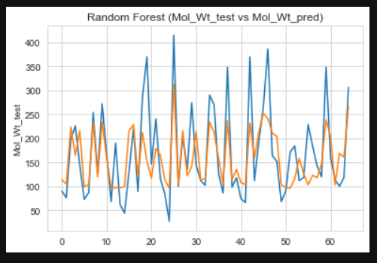
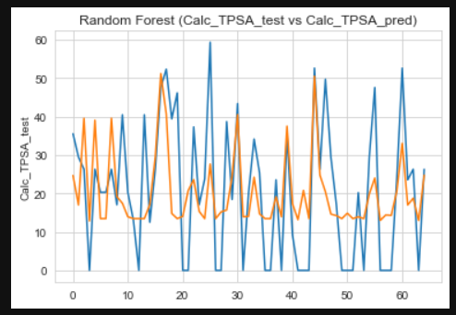
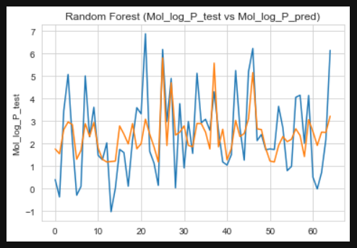
RANDOM FOREST REGRESSIOR

Slide 20
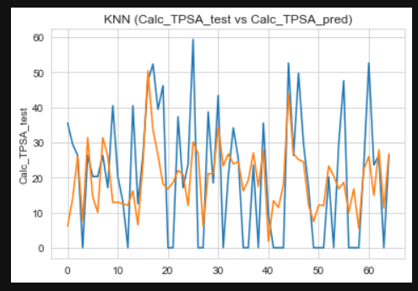
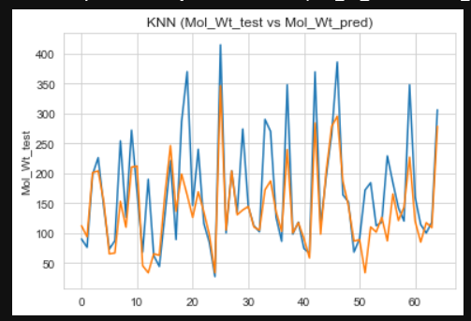
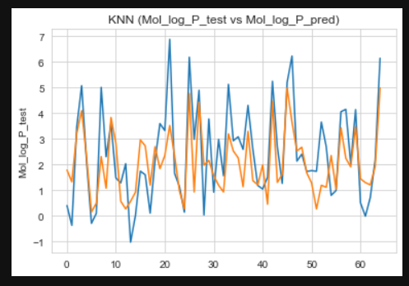
KNN REGRESSOR

Slide 21
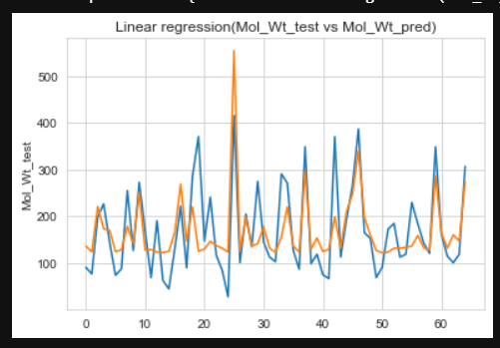
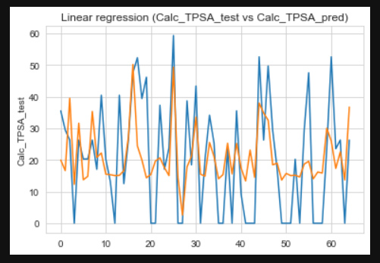
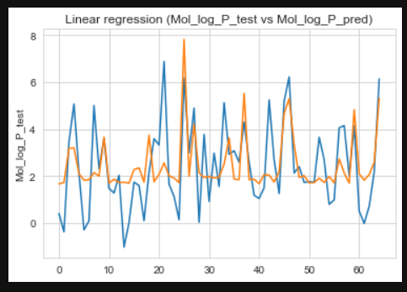
LINEAR REGRESSOR

Slide 22
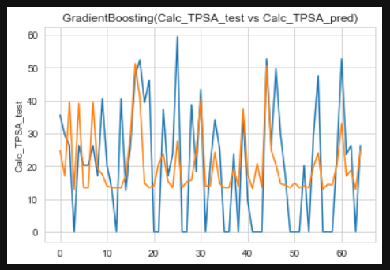
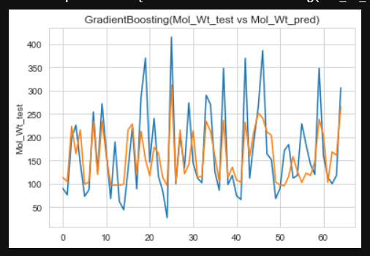
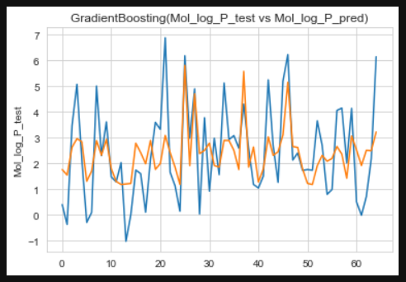
GRADIENT REGRESSOR

Slide 23

PERFORMANCE
METRIC
Metric are the measure of Performance on how well the Model performs.
Machine learning model were evaluvated
On 4 metrics.
R2 score
Adjusted R2 score
RMSE (root mean squared error)
MAE (mean absolute error)

Slide 24


Slide 25
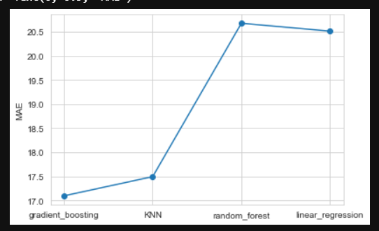
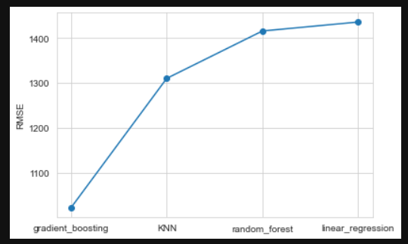
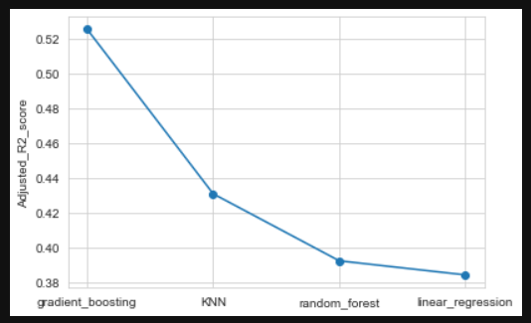
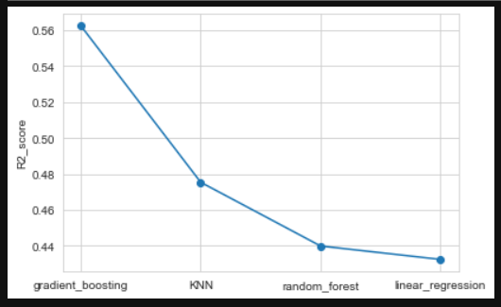

Slide 26
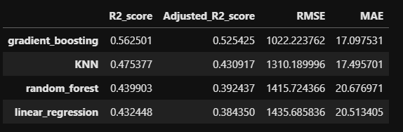

Slide 27

DUE TO LARGE AMOUNT OF DATA IN MILLIONS
IT WAS COMPUTATIONALLY EXPENSIVE PROCESS
OTHERWISE
IN CASE OF LARGE DATASET THE PERFORMANCE
FROM THE MODEL WOULD BE BETTER

Slide 28

FUTURE WORK
NEED TO MERGE OTHER AVALIABLE DATASET AND CHECK WITH METRICS AS THE ACCURACY WILL INCREASE IF MORE DATA IS AVAILABLE FOR TRAINING TESTING.
NEED TO HAVE MORE POWERFUL COMPUTER FOR LARGE DATASET EXPLORATION AS THIS PROJECT IS COMPUTATIONALLY EXPENSIVE
ALSO WORKING ON PREDICTION OF MASS SPECTRUM OF THE COMPOUNDS.

Slide 29

I WOULD LIKE TO THANK DR. SHOUYI WANG AND TEACHING ASSISTANT LINH HO FOR THEIR CONSTANT SUPPORT AND GUIDANCE.

Slide 30


